Slide 1
Thyroid disease classification using ML project based experiential learning program

Slide 2
Team Member
Priyanka.P
Vennila.S
Bhuvaneshwari.A
Roma.S

Slide 3
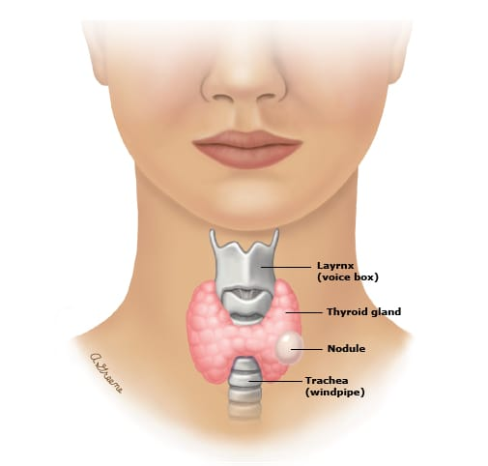
Thyroid gland
Butterfly-shaped endocrine gland.
Second largest endocrine gland in the body.
Weight about 30g in adults.
Principle hormones :T3, T4 & reverse T3.
It also secrete calcitonin.

Slide 4
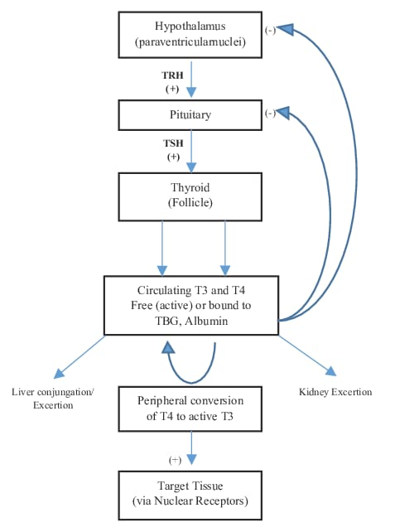

Slide 5
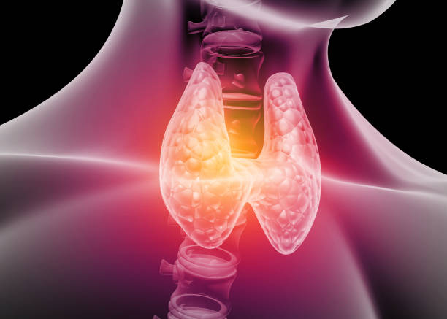
Definition of thyroid disease
Thyroid disease is a general term for a medical condition that keeps your thyroid from making the right amount of hormones.
Two types of thyroid.
1. Hypothyroidism
2. Hyperthyroidism

Slide 6
Hypothyroidism:
A condition in which the thyroid gland doesn’t produce enough thyroid hormone.
Hyperthyroidism:
The overproduction of a hormone by the butterfly-shaped gland in the neck(thyroid).

Slide 7
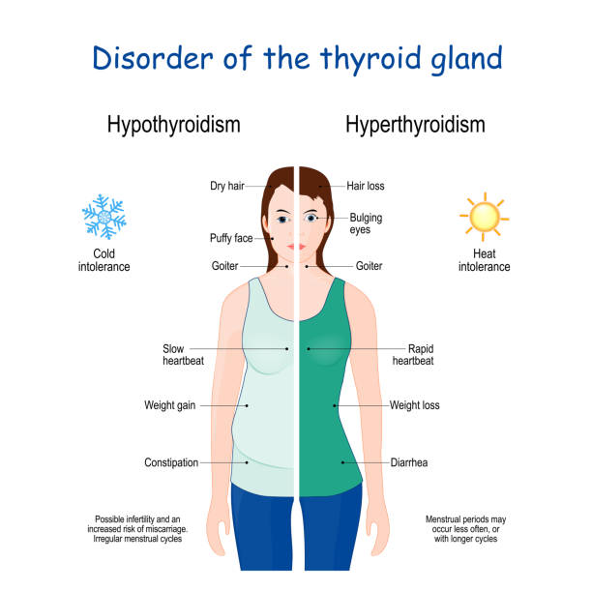

Slide 8
Signs & symptoms of hypothyroidism
Anxiety , depression or irritability.
Hoarse voice.
Weight gain.
High or low blood pressure.
Focus and memory problems.
Infertility and menstrual irregularities.
Slow heart rate.
Brittle nails, dry skin & hair loss.

Slide 9
Signs & symptoms of hyperthyroidism
Moist skin.
Protruding eyes.
Menstrual irregularity.
Hyperactivity frequent stools.
Weakness, especially in the legs.
Muscle aches.
High blood pressure.
Weight loss.

Slide 10
Thyroid disease view points
Western/ allopathic view
Either hypo(underactive)or hyper(overactive)
Primary , secondary or tertiary
Autoimmune or not
Not always checked
“Condition is not reversible”
Functional/holistic view
Can be hypo , hyper or oscillate between both
Autoimmune component is common and very important is consider
Causes or MANY

Slide 11
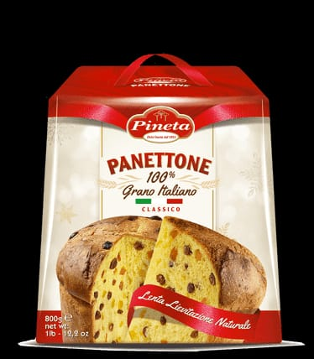

Causes of thyroid disease
Too much of this...
Not enough of this...

Slide 12
What causes thyroid disease?
Nutrient deficiencies
Iodine, selenium, good fats.
Adrenal dysfunction.
Autoimmunity.
Stress.
Emotional disturbances.
Food allergies.
Smoking.
Poor liver function.

Slide 13
To eat
Clean, non-GMO, organic sources.
High antioxidant foods.
Fatty fish.
Animal protein and organ meats.
Good fats
Coconut oil, olive oil, butter/ghee, avocado.
High vitamin C foods
Red bell pepper, kiwi, cauliflower, papaya.

Slide 14
To not eat
Goitregens
Cruciferous veggies
Soy
Peanuts
Nightshades.
Inflammatory and industrial oils.
Processed and devitalized foods.

Slide 15
Conclusion
Incidence of thyroid cancer in children is increasing.
Thyroid nodules in children more likely to be malignant than thyroid nodules in adults.
Early detection and treatment of thyroid cancer in children is associated with a favorable outcomes.
Thyroid dysgenesis is most common cause in the US.

Slide 16
“FIT AND HEALTHY TOOK LOOKING BEYOND HER THYROID”
THANK YOU!!!

